Slide 1
Crew and Fleet Avocado Developed by Jeppesen Crew Academy

Slide 2
Teacher presentation <name/role> <email@jeppesen.com>
<Background information>
Notes:
Possibly hide this slide and replace with your personal teacher presentation slide, or show it separately.

Slide 3

Practical Details
Restrooms – in the corridor, to the right
Coffee breaks - around 10.15 and 15.00 (water and fruit located in the back of the course room)
Phones - are turned off (or kept on silence) and phone calls are taken outside the training room
Internet browsing, typing e-mails etc. is done during breaks.
Lunch arrangements
Evaluation

Slide 4

Participants presentation
Name, company
Role
Experience
Your expectations
<Other>

Slide 5

Course goals
You will have:
Basic understanding of the capabilities of the crew and fleet products
Basic understanding of the roles needed to use the crew planning products successfully
Basic understanding of the customization possibilities offered

Slide 6
Prerequisites
None
Please –
Don't be afraid to ask questions if anything is unclear!

Slide 7
Course material
Course slides

Slide 8

Agenda Day 1
09:00 - 10:15 Crew Management Process
10:15 - 10:30 Coffee break
10:30 - 12:30 Roles and Interaction The Avocado
12:30 - 13:30 Lunch
13:30 - 15:00 Optimization 15:00 - 15:15 Coffee break
15:15 - 17:00 Modelling the problem and customizing the system
The Major Release Process
Course Evaluation
All times are approximate – changes may/will occur
Short breaks every ~40 minutes or so

Slide 9
Chapter 1
Crew Management Process

Slide 10
Typical processes
Yield
Passenger
forecasts
Operation Control
Fleet
Timetable
planning
Fleet
Assignment
Tail
Assignment
Timetable / Tail
Maintenance
Aircraft Routings
Crew
Manpower
Crew Pairing
Crew Rostering
Roster Maintenance
Rosters
Vacation &
Training
Notes:
Crew planning is tightly linked to Passenger Forecasts and Fleet planning.
If it is possible to sell many tickets on a flight it is beneficial to have a larger aircraft,
this will in turn most likely result in a need of more cabin attendants and possibly pilots with different qualifications.

Slide 11
Applications / Services
Long-term Planning
Planning
Maintain Planning
Day of Operation
Follow up
Passenger Recovery
Manpower Planning
Crew Pairing
Crew Recovery
Crew Rostering
Crew Tracking
Crew Management
Tail Assignment
Fleet Recovery
Fleet Tracking
Fleet Management
Disruption Management
Schedule Safety / FRMS related services
Remote Planning
Hosting
Business Consulting

Slide 12
Crew management process
Manpower
Crew Pairing
Crew Rostering
Pairing & Roster Maintenance
Day of Operation
Notes:
Before we start talking about the Crew Planning process we need to put it in its context.

Slide 13
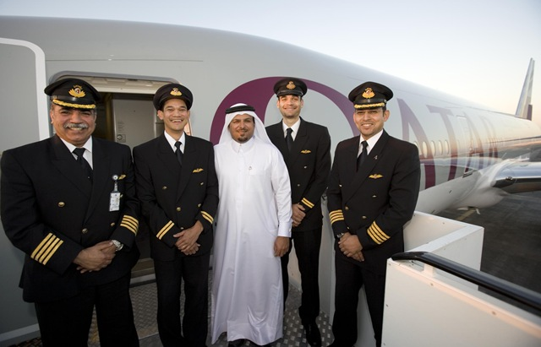
Crew management process Manpower
Manpower
Crew Pairing
Crew Rostering
Pairing & Roster maintenance
Day of Operation
Notes:
Qatar Airways just took delivery of their first Boeing 777 – 200 LR.
Here we see Executive Vice President Flight Operations Captain Abdullah Johar greeting
the flight deck crew after a 15 hour non stop flight from Boeing’s manufacturing base in Seattle to Doha.
They use Jeppesen Crew Pairing and Jeppesen Crew Rostering.
Making it the sixth Boeing 777 for Qatar Airways.
Qatar is one of the Airlines that are growing very rapidly at the moment.
The middle east, asia with China and India is where the market is growing the fastest right now.
The ones with three stripes are captains and the two with only two stripes are first officers.
When you get a 250 million US$ plane you want to start using it in production as fast as possible, so it is important to have
Crew with the right type of qualifications
Manpower planning
Long term 1-5 years
Mid term planning 3 months - 1 year
Short term untill 3 months
Establishment- resource planning:
Right amount of crew for rostering phase. How much vacation, recruiting / firing, transition training?
Match production with resources. Enough instructors, language qualifications.
Vacation planning:
Give out vacation according to bids if not done in rostering phase.
Training planning:
Training optimization – Who and when
Matching the transition planning.
Bids for fleets, rules for who is allowed to transition and how to move between fleets.
Courses for recurrent training.
Recurrent training, decide on how much recurrent training is needed and how much is possible.

Slide 14
Crew management process Crew Pairing
Manpower
Crew Pairing
Crew Rostering
Pairing & Roster maintenance
Day of Operation
Create anonymous trips starting and ending at a base
Start from home base
Stay in hotel
MAD
234
FRA
301
ARN
306
FRA
FRA
340
CPH
119
MAD
Back to home base
Covering flights 234, 301, 306, 340 and 119
Notes:
Ideal the pilot should work on the aircraft all day, but it is not possible for a pilot to get up at 5 and work until 11.
It is also about quality of life. The aircraft could go GOT-LHR all day every day but the pilot would not like it.
Crew Pairing planning is done between 3 and 8 weeks before day of operation.
Create anonymous flight sequences respecting flight regulations.
Minimize cost, maximize quality of life and robustness.
A trip goes back to base where the crew live. Start and end at home base is a restriction.
Someone should perform this work but you do not know who.
There are other restrictions. Pilots are only qualified toy fly certain aircraft types.
Regulations say how long trips you may build.

Slide 15
Crew management process Crew Pairing
Manpower
Crew Pairing
Crew Rostering
Pairing & Roster maintenance
Day of Operation
Timetable Rotations OAG file Leg crew need Legal rules Quality aspects Cost definitions Rostering aspects Report definitions
Crew Pairing system
Trips Reports

Slide 16
Crew management process Crew Rostering
Manpower
Crew Pairing
Crew Rostering
Pairing & Roster maintenance
Day of Operation
Create personal schedules for each crew member
Pre-assignments
Pairings
Ground duties
Training
Notes:
Regulations on how to combine trips. Duty time in month, duty end before vacation.
Quality of life like no long sequence of early duties.
Example of ground duties are courses, standby.
The reason for first making pairings and then rosters are historical. It was a natural breakdown of the problem.
Airlines work to get the timeframe of planning smaller. Work is going on to solve pairing and rostering in one shot.
Crew wants info on their work schedule well in advance. The trend is the crew looses the battle of early notification vs. late planning.

Slide 17
Crew management process Crew Rostering
Manpower
Crew Pairing
Crew Rostering
Pairing & Roster maintenance
Day of Operation
Crew
Unassigned trips
Ground duties
Pre-assignments
Bids
Crew Rostering system
Rosters
Reports

Slide 18
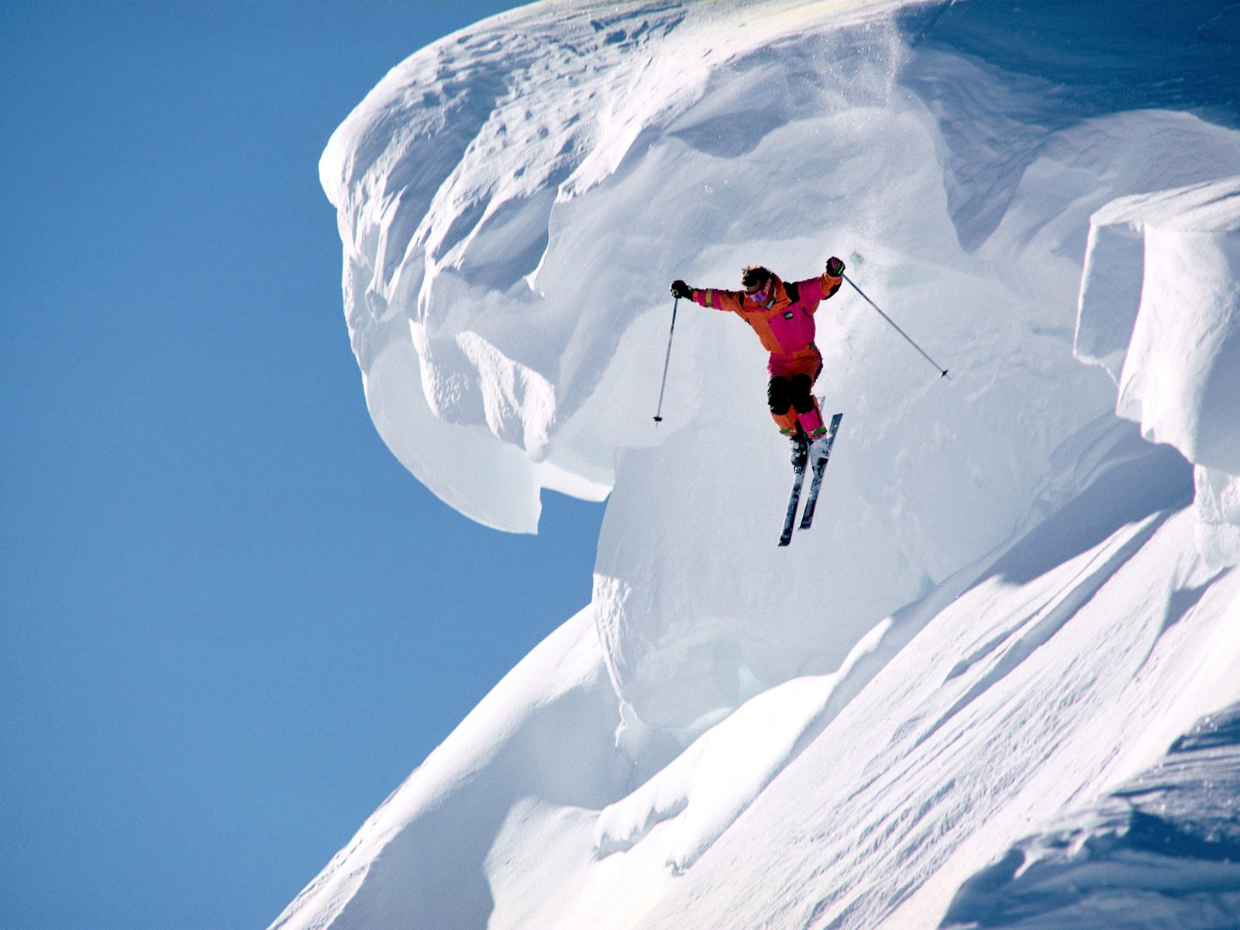
Crew management process Pairing & Roster Maintenance
Manpower
Crew Pairing
Crew Rostering
Pairing & Roster maintenance
Day of Operation
Notes:
Tracking includes both maintenance of pairings and rosters as well as solving the problem on the day of operation.
Pilot Andersson breaks his leg two weeks before he shall fly. You know in advance and can maintain the roster.
Or you get fog in Montreal. Panic things. Solvers for the day of operation.
How maintenance is done differs between airlines. Some are good at it, some other do not bother – there will be a fog anyway…..

Slide 19
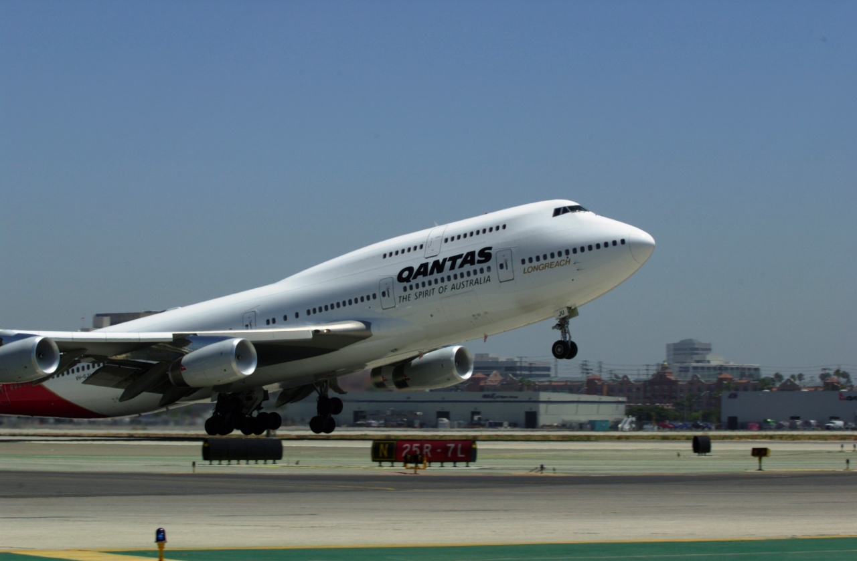
Crew management process Day of Operation
Manpower
Crew Pairing
Crew Rostering
Pairing & Roster maintenance
Day of Operation

Slide 20
Crew management process Day of Operation
Manpower
Crew Pairing
Crew Rostering
Pairing & Roster maintenance
Day of Operation
Information overflow
Many interruptions
Expectations
from crew
Search for
problems
Time pressure
09:00
09:05
09:10
09:15
09:20
Lack of information
Very short deadlines
- Every departure is a deadline
Complicated agreements/reguations

Slide 21


Crew management process
Manpower
Crew Pairing
Crew Rostering
Pairing & Roster maintenance
Day of Operation
Notes:
”Follow Up” on what actually happneded, look-back functionality
Real values entered
Pay
Analytics

Slide 22
Crew management process
Manpower
Crew Pairing
Crew Rostering
Pairing & Roster maintenance
Day of Operation
Cost
1 year
2 months
1 month
72 hours
Time

Slide 23
Exercise 1
~30 mins

Slide 24
Exercise 1 summary
Notes:
Remind all instructors of what may be a good idea to discuss/mention after the exercises...

Slide 25
Chapter 2
CMS Team Roles
Main Customer Roles

Slide 26
CMS Team Roles
Customer:
Customer roles involved in CMS:
Business Owner
Project Manager
Business Analyst
Ambassador User
Crew Ambassador
Planner
Tracker
Crew
Developer
CMS Administrator

Slide 27
CMS Team Roles
Customer Tasks:
Drive business value, maintain CMS vision, strategy and roadmap for airline
Have an awareness of the CMS capabilities and prioritize resources
Plan for and implement new releases
Make sure that Business and IS/IT are aligned in plan, budget and resources for change requests, migration and training
Participate in Users Conference
Knowledge of several Project Control methodologies and utilizes the most applicable
Team leadership
Plan implementation project tasks, activities and training
Hold regular internal meetings
Participate in regular Jeppesen project meetings
Distribute minutes of meetings
Run and analyze “what-if” scenarios
Act as expert on optimization goals
Refine planning process
Participate in Users Conference and Crew&Fleet Development Partner Conference
Customer Tasks Cont.:
Act as expert on solution quality, day-to-day tuning
Maintain the step-by-step guide (cookbook)
Handle end user support, mentoring
Test new releases, service packs
Assist communication between Planning/Operations and Crew, explains concepts Assume responsibility for training and answering questions
Conducts crew training and support
Gather, set up and prepare data for planning
Create schedule / plan (including pre-assignments)
Evaluate and analyze optimized solutions
Tracking
(Prepare for) Follow up
Place preferences, trade trips and vacation
View roster and acknowledge notifications
Customer Tasks Cont:
Perform optimization tuning (performance)
Maintain data interfaces
Develop and maintain customization/configuration
Maintain functional reference manual
Specify and prioritize change requests (CR)
Specify and prioritize bugs
Interact with Jeppesen CPS
Participate in Crew&Fleet Development Partner Conference
CMS administration
Security Administration
System operation
System administration
Database administration

Slide 28
CMS Team Roles
Jeppesen:
Jeppesen roles involved in CMS:
Portfolio Management / Product Manager
Project Manager / Program Manager
Business Analyst
Business Consultant
System Architect
Developer
Deployment Specialist
SME (Subject Matter Expert), within Products, Tools, and Optimization.
Service Manager (SM) / Service Account Manager (SAM)
Key Account Manager, Sales Executive
Teacher

Slide 29
Main customer roles
Administrator
Developer
Business Analyst
Planner / Tracker
Ambassador User

Slide 30
Business Analyst
Administrator
Developer
Business Analyst
Planner / Tracker
Ambassador User
Tasks:
Run and analyze “what-if” scenarios To evaluate the possible outcome of proposed or foreseen changes.
Act as expert on optimization goals To fully utilize the complete potential of the optimizers.
Refine planning process To continuously adapt CMS to business changes.
Participate in Users Conference and Crew&Fleet Development Partner Conference To cooperate with Jeppesen in strategy and roadmap work.

Slide 31
Business Analyst
Administrator
Developer
Business Analyst
Planner / Tracker
Ambassador User
Skills and experience:
Analytical mind set
In-depth air/rail business knowledge
In-depth planning and operations knowledge
Knowledge of (regulatory) rules and agreements and their application
Excellent communication skills.

Slide 32
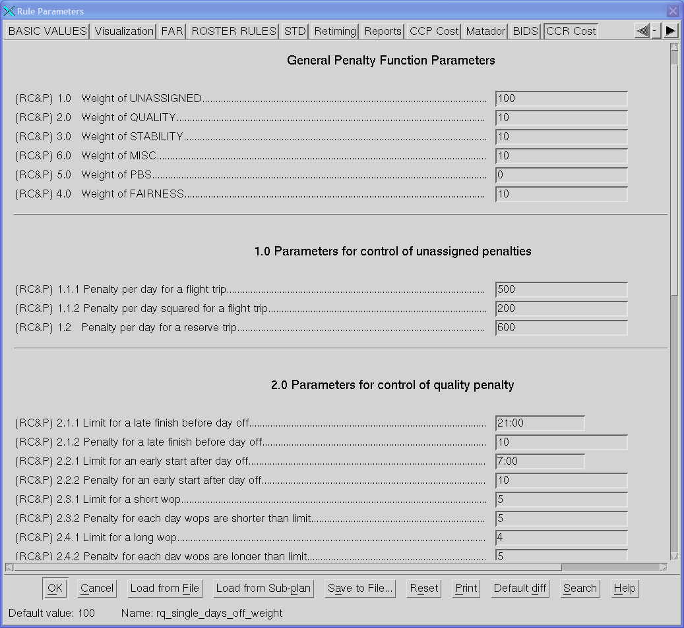
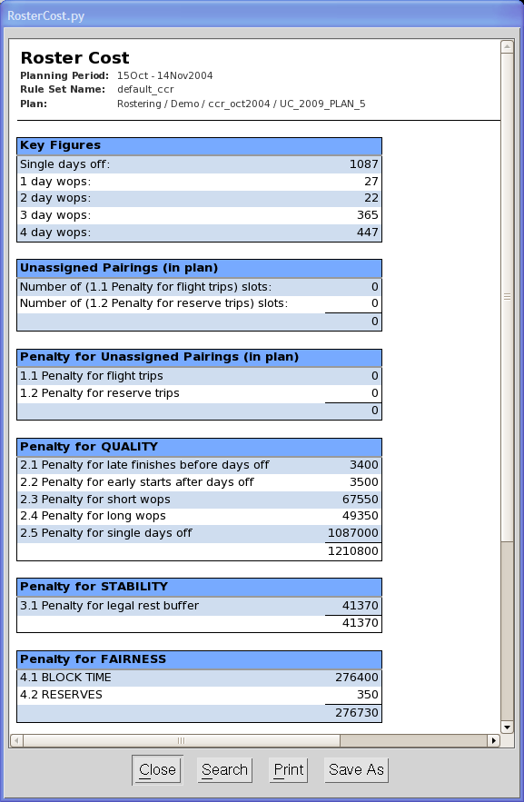
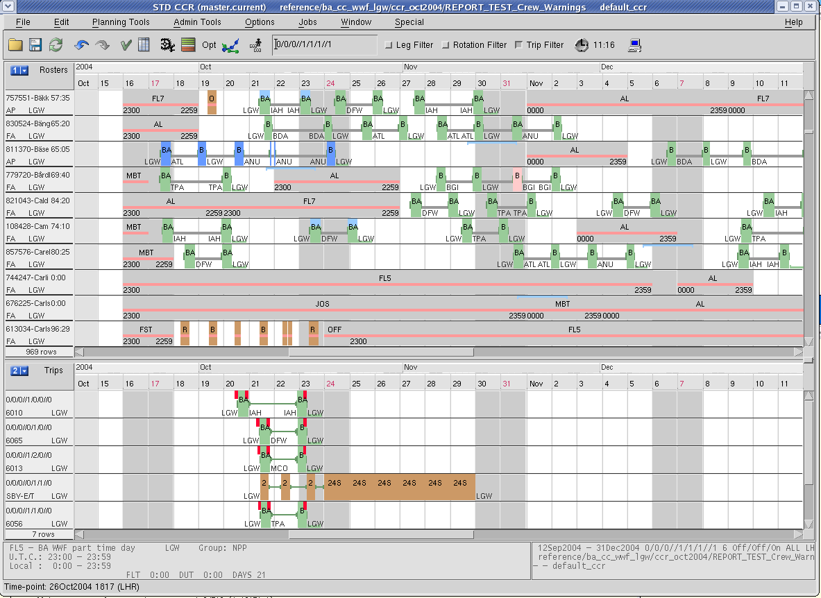
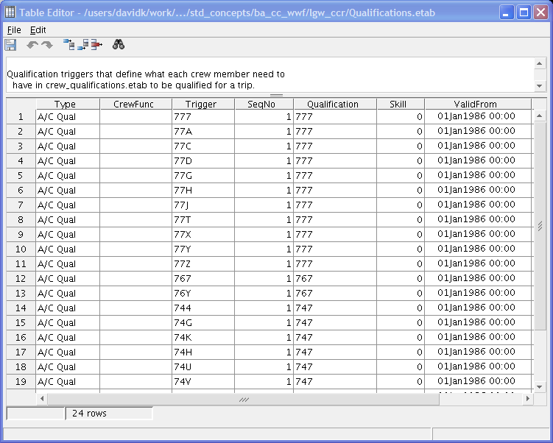
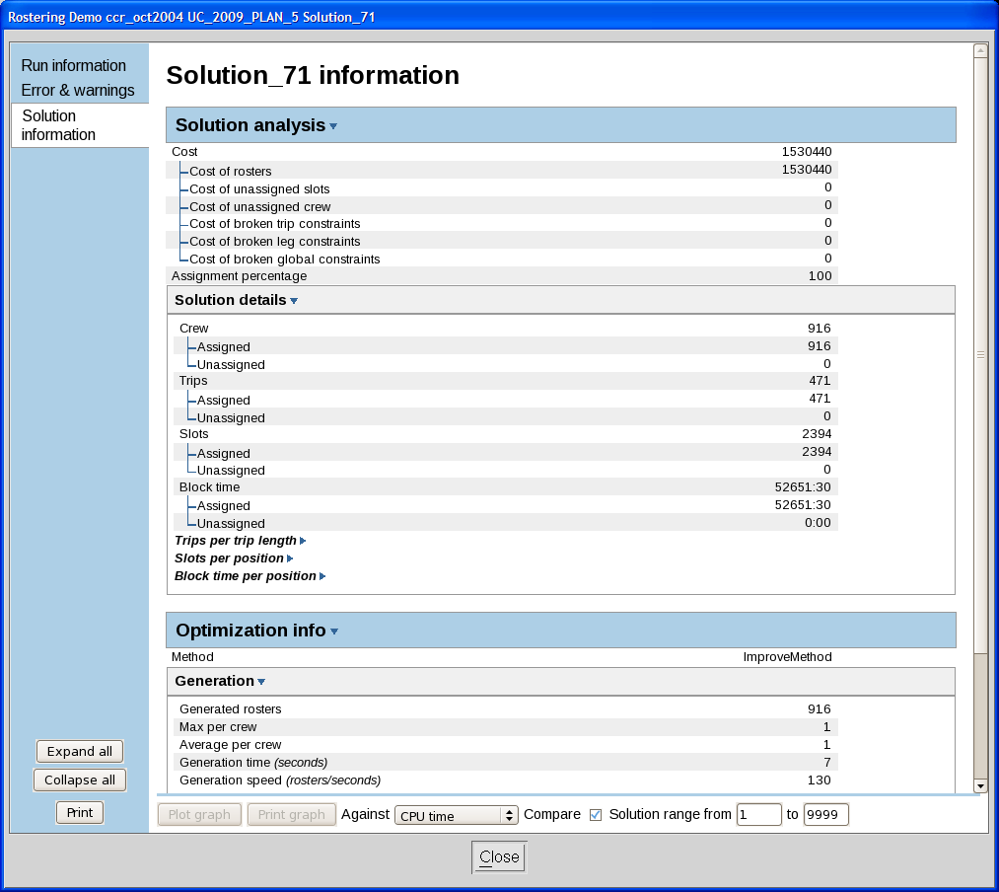
Business Analyst
Administrator
Developer
Business Analyst
Planner / Tracker
Ambassador User

Slide 33
Ambassador User
Administrator
Developer
Business Analyst
Planner / Tracker
Ambassador User
Tasks:
Act as expert on solution quality, day-to-day tuning To share knowledge within the team and utilize the optimizers as effectively as possible.
Maintain step-by-step descriptions used by Planners or Trackers in their daily work (cookbook), i.e. the CMS part of the planning process To make sure the team works as effectively as possible.
Handle end user support; mentor (how to use the system) To make sure the team works as effectively as possible.
Test new releases, service packs To verify expected behavior and quality.

Slide 34
Ambassador User
Administrator
Developer
Business Analyst
Planner / Tracker
Ambassador User
Skills and experience:
Planning / Tracking experience with Jeppesen CMS
Good technical skills
Excellent communication skills.

Slide 35
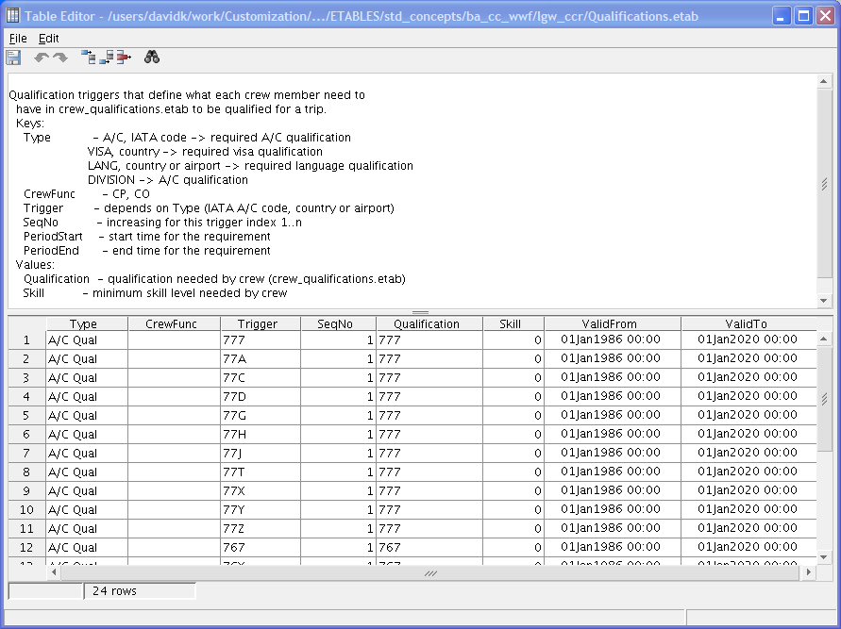
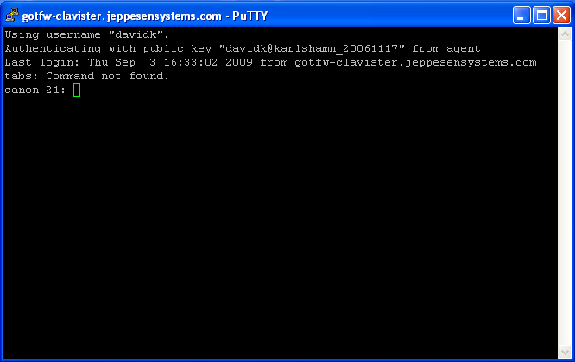
Ambassador User
Administrator
Developer
Business Analyst
Planner / Tracker
Ambassador User

Slide 36
Planner / Tracker
Administrator
Developer
Business Analyst
Planner / Tracker
Ambassador User
Tasks:
Gather, set up and prepare data for planning To make sure that data is up-to-date and optimal pre-conditions apply
Create schedule / plan (including pre-assignments) Create headcount, leave plan and transition training plan (Manpower) Handle disruptions in crew plans (Tracking) To distribute the current workload on available crew
Evaluate and analyze optimized solutions To create optimal schedules.

Slide 37
Planner / Tracker
Administrator
Developer
Business Analyst
Planner / Tracker
Ambassador User
Skills and experience:
Planning experience
Business knowledge
Analytical.

Slide 38
Planner / Tracker
Administrator
Developer
Business Analyst
Planner / Tracker
Ambassador User
Manpower
Crew Pairing
Crew Rostering
Pairing & Roster Maintenance
Day of Operation

Slide 39
Planner / Tracker
Administrator
Developer
Business Analyst
Planner / Tracker
Ambassador User
Manpower
Crew Pairing
Crew Rostering
Pairing & Roster Maintenance
Day of Operation
Import data
Manual assignment
Optimization
Evaluation
Publication
Pre-processing

Slide 40
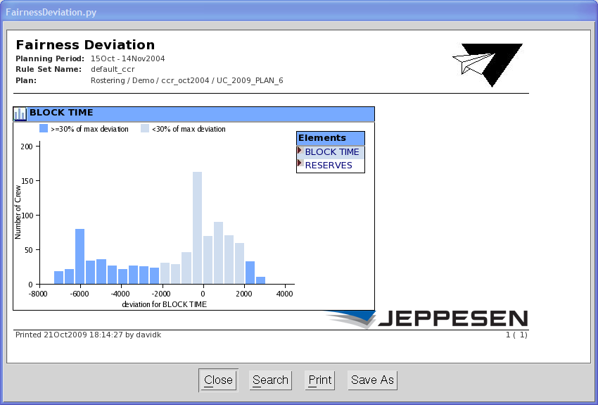
Planner / Tracker
Administrator
Developer
Business Analyst
Planner / Tracker
Ambassador User

Slide 41
Developer
Administrator
Developer
Business Analyst
Planner / Tracker
Ambassador User
Tasks:
Perform optimization tuning (performance) To make sure the optimizers work as efficiently as possible
Maintain data interfaces To adapt to business and technical changes
Develop and maintain customization/configuration, such as:
Rave code
Report code
GUI
Automation
To adapt to business changes and make sure Planers and Trackers can work as effectively and efficiently as possible.
Maintain functional reference manual To communicate the current system behavior.

Slide 42
Developer
Administrator
Developer
Business Analyst
Planner / Tracker
Ambassador User
Tasks (cont.):
Specify and prioritize change requests (CR)* To communicate (internally and externally) needed changes and their expected outcome
Specify and prioritize bugs* To communicate system faults to Jeppesen
Interact with Jeppesen CSS To share information and work together
Participate in Crew&Fleet Development Partner Conference To cooperate with Jeppesen in strategy and roadmap work.
* The Developer will report CRs and bugs to Jeppesen but all stakeholders will report CRs and bugs to the Developer.

Slide 43
Developer
Administrator
Developer
Business Analyst
Planner / Tracker
Ambassador User
Skills and experience:
Minimum 12 month work related programming experience
Willing to learn & understand the business
Good communication skills
Problem solver.

Slide 44
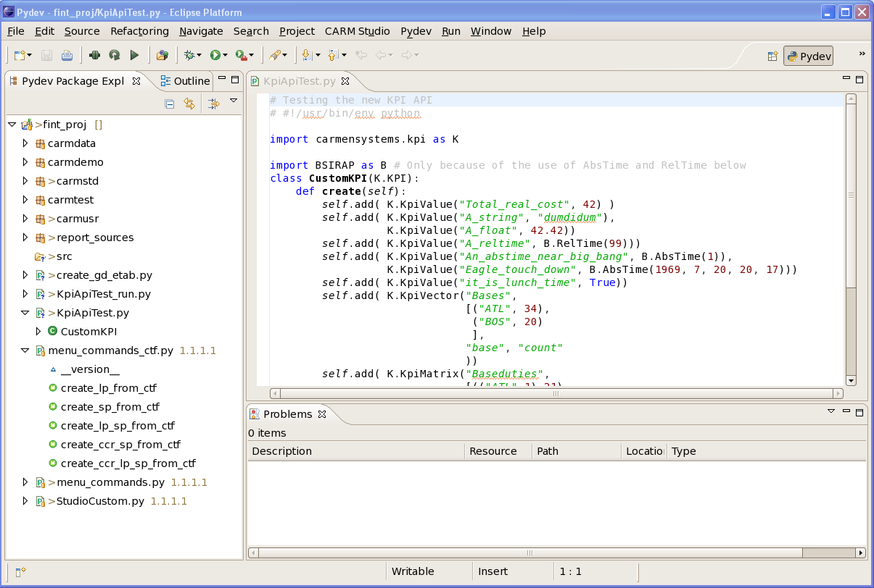
Developer
Administrator
Developer
Business Analyst
Planner / Tracker
Ambassador User
Notes:
Vision is to do all customization tasks in DWS.

Slide 45
Administrator
Administrator
Developer
Business Analyst
Planner / Tracker
Ambassador User
Tasks:
CMS Administration
Install CMS (Carmsys + Carmutil + Carmusr)
Manage data (e.g. archiving, backup, move data)
Interact with IT department (system administrator)
Security
System Operation
System Administration
Database Administration.

Slide 46
Administrator
Administrator
Developer
Business Analyst
Planner / Tracker
Ambassador User
Skills and experience:
Excellent technical skills
Some business knowledge (CMS Admin)
Good communication skills
System Administration skills in general
Database Administration skills in general.

Slide 47

Administrator
Administrator
Developer
Business Analyst
Planner / Tracker
Ambassador User

Slide 48

The Roles Summary
Jeppesen CMS
Business Analyst
Planner / Tracker
Developer
Ambassador User
Administrator

Slide 49

Crew
Tasks:
Place Preferences (bids / requests) and trade trips and vacation To communicate wishes and actively maintain the roster
View roster and acknowledge notifications To verify and acknowledge rosters changes.
Skills and experience:
Basic computer skills.

Slide 50
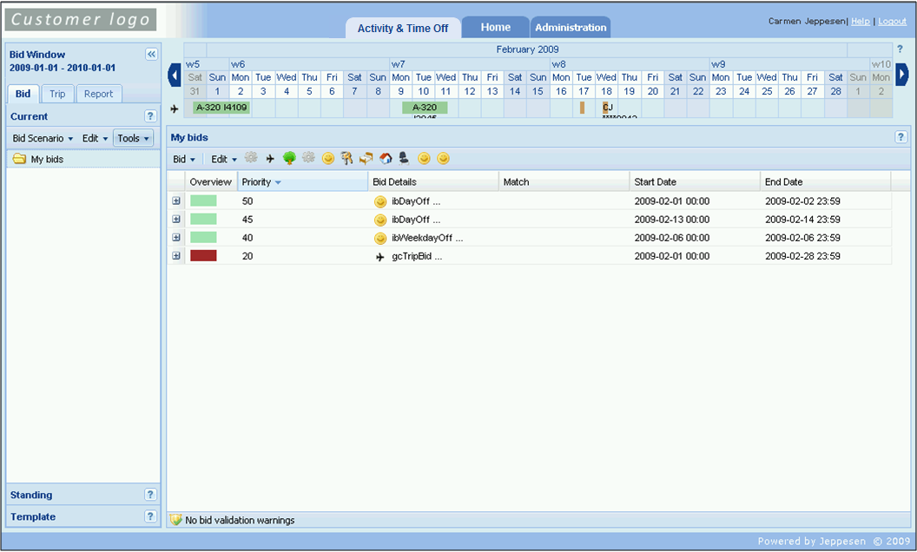
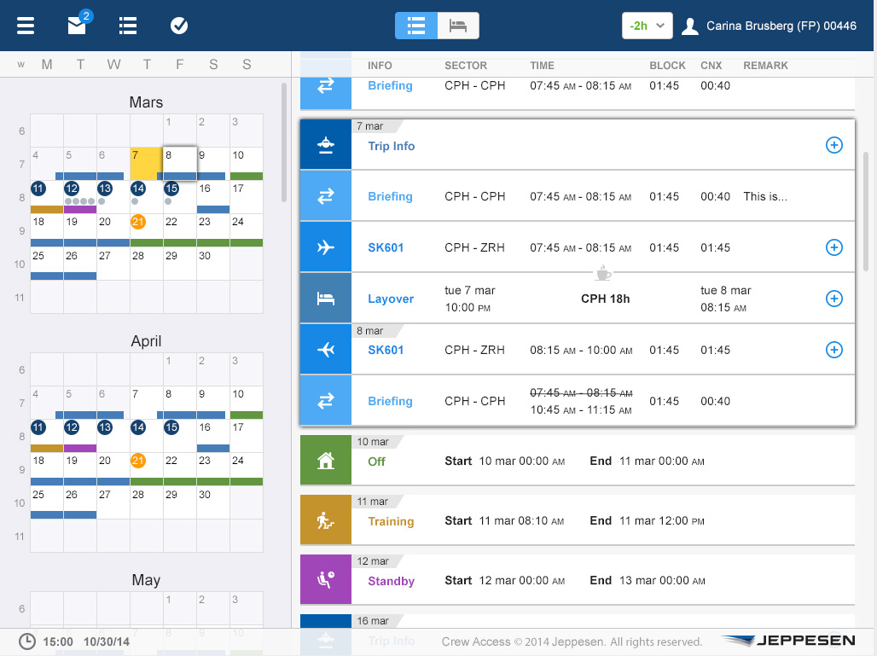
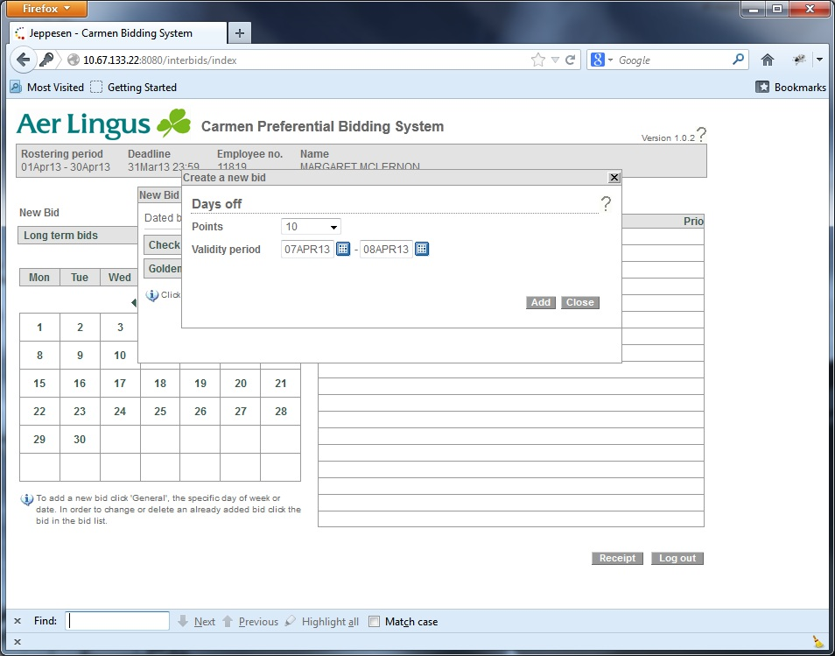
Crew
mWeb generation Crew Modules
Mobile optimized web application with responsive design developed on WPF (new web & mobile archteture)

Slide 51
Exercise 2
~30 mins
Notes:
Divider slide to introduce an exercise.

Slide 52
Exercise 2 summary
Notes:
Remind all instructors of what may be a good idea to discuss/mention after the exercises...

Slide 53
Chapter 3
The Avocado
– and why it is a good fit!

Slide 54
The Airline Industry
What are some characteristics
of the Airline Industry in general?
What is the current market outlook?
What does this mean for Crew Planning?
Notes:
Goes up and down with business cycles, very quickly.
Current market outlook varies from course to course.
- Low cost, fuel efficiency
This means Crew Planning needs to be flexible.

Slide 55





























Clients
…and more
Notes:
There are more clients, e.g. Green Cargo, DB and Swiss…

Slide 56
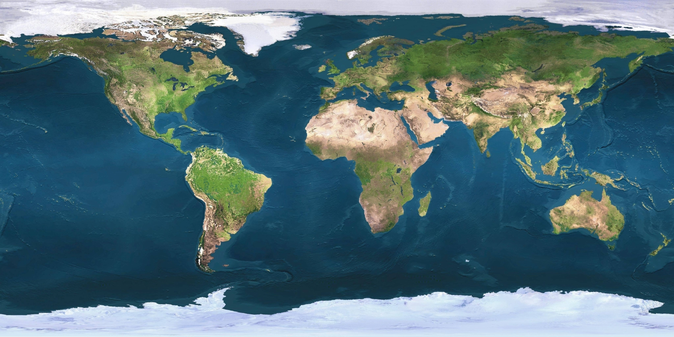
Clients
…and more
Notes:
There could be more dots, this is to show that we are all over the world...

Slide 57
The Avocado
Conventional Software Architecture
Jeppesen Software Architecture
United
Legality
Optimizer parameters
Legality
Optimizer parameters
Security
User Interface
Data engine
Rule engine
Report engine
Optimizers
System
Core
British Airways
Configure
GUI
Lufthansa
Configure GUI
Saudia
Automation
Extend
data
model
Security
User Interface
Optimizers
Reports
Reports
Data model
Automation
Interfaces to external systems
Interfaces to external systems

Slide 58
The Avocado
Outer skin Simple changes via parameters
Look & Feel
Preferences
Soft layer Business logic described through modelling language (Rave™)
Layer owned and modified by airline after the initial set-up.
Hard centre Provides common core functionality to all clients
Layer owned and modified by Jeppesen

Slide 59
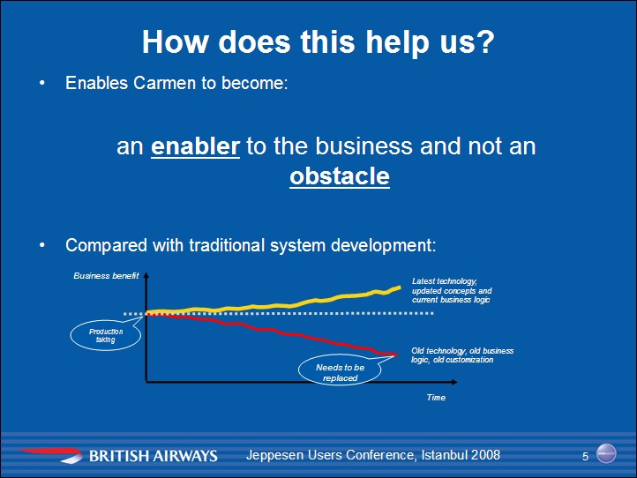
The Avocado Solving Problems

Slide 60
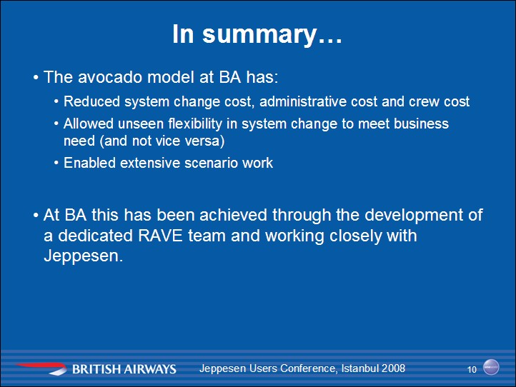
The Avocado Crew planning process

Slide 61
Exercise 3
~30 mins
Notes:
Divider slide to introduce an exercise.

Slide 62
Exercise 3 summary
Notes:
Remind all instructors of what may be a good idea to discuss/mention after the exercises...

Slide 63
Chapter 4
Optimization
– what it is
– and how it works

Slide 64
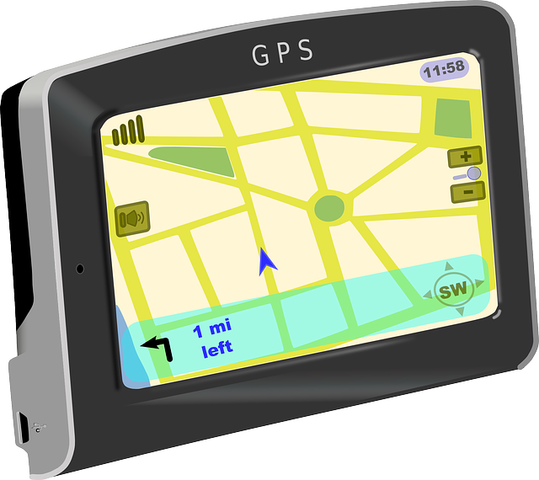




Optimization

Slide 65
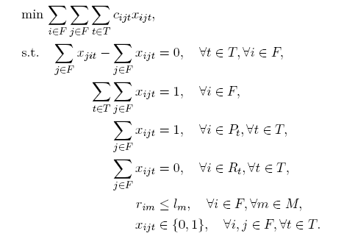
Optimization Solving Problems
What is optimization?

Slide 66
Optimization Definition
Merriam Webster:
op-ti-mi-za-tion n (1857) : an act, process or methodology of making something (as a design, system, or decision) as fully perfect, functional, or effective as possible; specif: the mathematical procedures (as finding the maximum of a function) involved in this

Slide 67
Optimization Crew planning process
Our view:
Optimization = Finding the best possible solution to the right problem as fast as possible.
The three dimensions:
Best
Solution
Speed
Right Problem

Slide 68
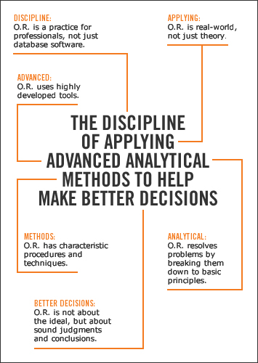


Optimization Operations Research
Notes:
Operations Reseach is its own field, with research and communities. There is plenty to read, books, white papers, thesis work etc ... Google for more info.

Slide 69
Optimization Solving Problems
Find the shortest route in the network,
taking you from A to B:
B
A

Slide 70
Optimization Solving Problems
Fit as much as you can in your bag:

Slide 71
Optimization Solving Problems
What is the best solution?
Quickest?
Shortest?
Nicest?
Weight?
Value?
Size?
A
B

Slide 72
Optimization Solving Problems
There’s a simple way of finding the optimal solution to the planning problem:
Generate all possible solutions (sets of rosters)
Select the best solution.

Slide 73
Optimization Solving Problems
How difficult is the crew planning problem?
>10²⁵
Possible rosters per month
Notes:
Assume 10.000 crew
Assume 10.000 trips with an average complement of 6
Each crew should have 6 trips in one month
Chose 6 trips from 10.000 ➔ 1.386...x10^21 possibilities
... x 10.000 crew = 1.386 x 10^25

Slide 74

Optimization Solving Problems
Is 10²⁵ a big number?
Estimated number of stars in the universe:
10²¹

Slide 75
Optimization Crew planning problem
All possible solutions (sets of rosters)
A solution
Too many possible solutions.
Optimal solution
An illegal solution

Slide 76
Optimization Crew planning problem
A quality rule limits solution space
The used methods search only parts of the solution space
This solution will not be considered

Slide 77
Optimization Crew planning problem
Two main steps:
Model the problem: Define the objective function and the rules/constraints
Solve the problem: Apply the best algorithm(s) to the problem

Slide 78
Optimization Objective Function
When you solve problems automatically, all solutions should be ordered. This guides the optimizer when generating solutions and is the only way to identify the best solution.
Solution A is better than solution B, but solution C is better than both and therefore the best.
C
A
B
Objective function

Slide 79
Exercise 4
~30 mins

Slide 80
Exercise 4 summary
Notes:
Remind all instructors of what may be a good idea to discuss/mention after the exercises...

Slide 81
Chapter 5
Modelling the problem and customizing the system
– What tools are there

Slide 82
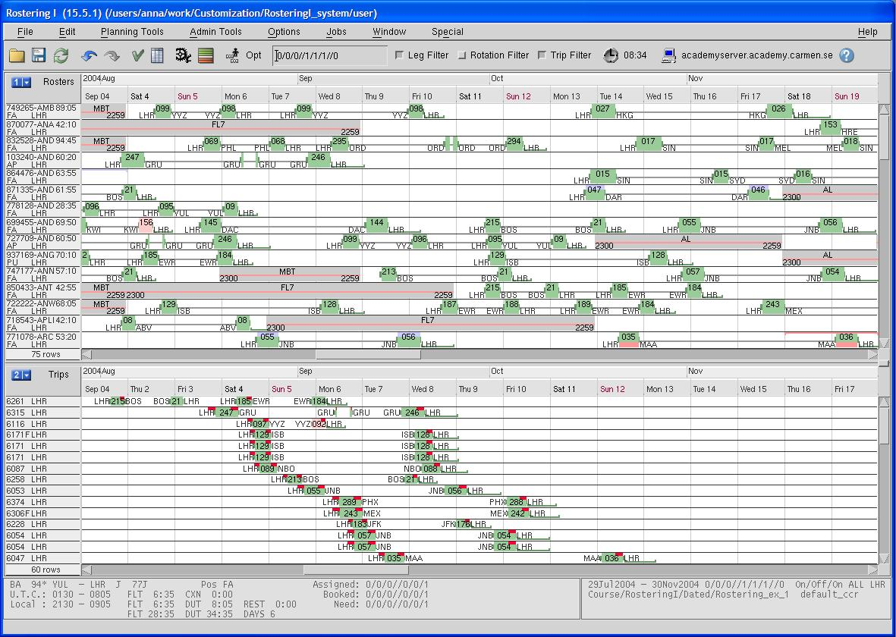
The Problem
Rosters
Best possible way
Assignable objects

Slide 83
Model the Problem
Two main steps:
Model the problem: Data model Define rules/constraints and the objective function Reports & Customization
Solve the problem: Apply the best algorithm(s) to the problem

Slide 84
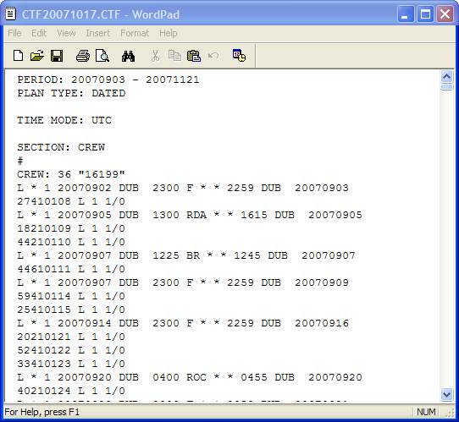
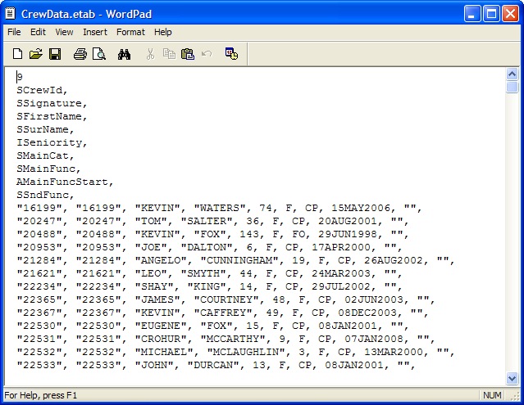
Model the Problem Define Data
Planning data
Crew
Ground duties
Pre-assignments
Bids
Etables (Custom External Tables) All other data needed during planning
SSIM (timetable) CTF (Trips, Rosters)
Notes:
Scripts are used to transfer and compile data from other sources, e.g. mainframes and databases, into etables.

Slide 85
Model the Problem Define rules/constraints
All solutions need to be legal!
According to:
Legal rules
EU OPS, FAR, CAP 371 ...
Union rules
Agreements between airline and unions
Quality rules
Common practice, Buffers for stability ...

Slide 86
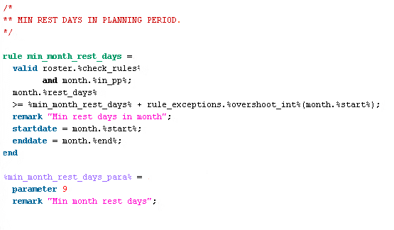
Model the Problem Define rules/constraints
RAVE = Rule And Value Evaluator

Slide 87
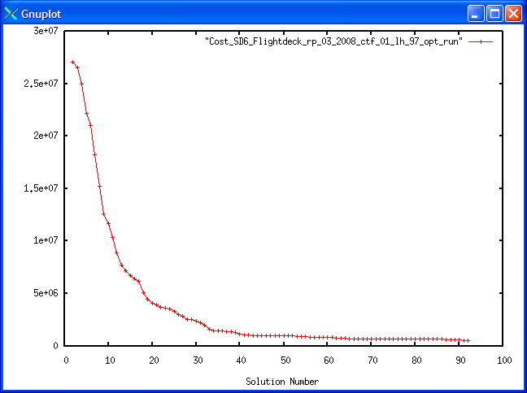
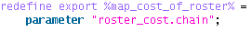
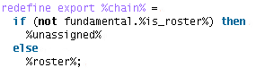
Model the Problem Define objective function
Best possible way
Objective function in RAVE

Slide 88
Model the Problem Define objective function
Given a certain objective function, the value of the objective function (often called total cost) for the rosters or pairings consists of real costs and penalties:
Real costs 18,700 Jeppesen$
Penalties 46,520 Jeppesen$
Total costs 65,220 Jeppesen$

Slide 89
Model the Problem Define Penalties
Define patterns that add costs and group them
Set priorities between objective groups
Cover production
Bid ratio
Stability
Quality
The weighting of these aspects can be refined by Planners through parameters
...

Slide 90
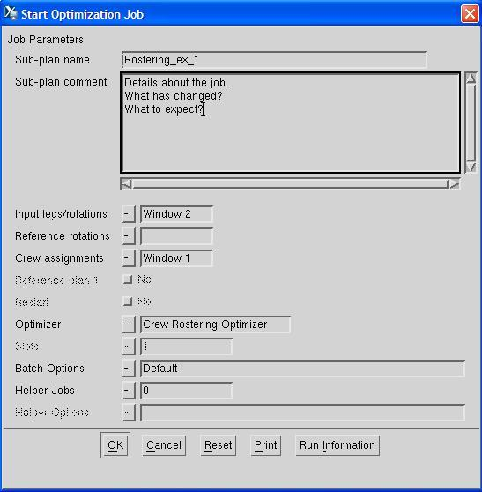
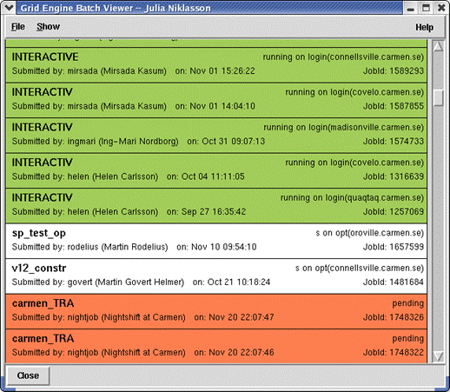
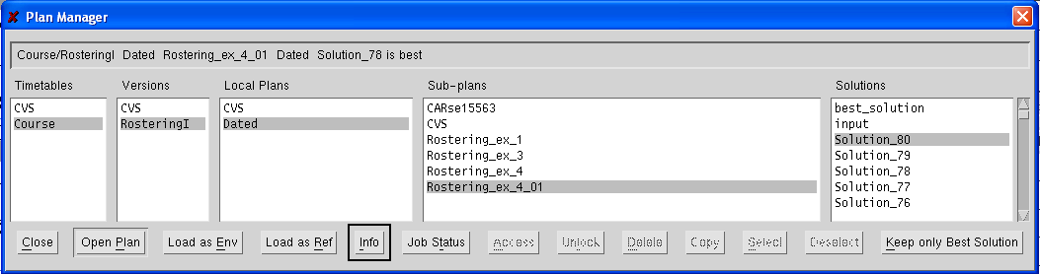
Model the Problem Optimization

Slide 91
Customizing the System
GUI
Reports
Automation

Slide 92
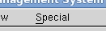
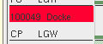
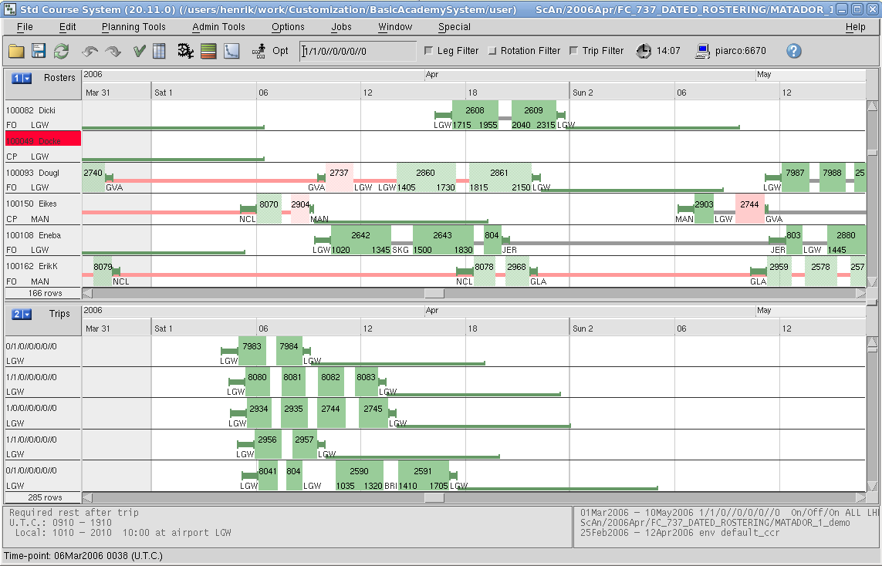
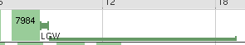
Customizing the system Graphical User Interface (GUI)

Slide 93
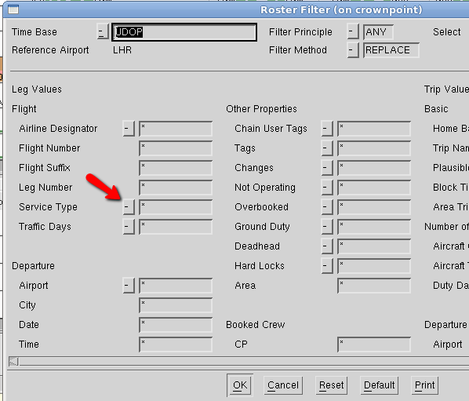

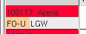
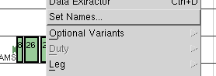
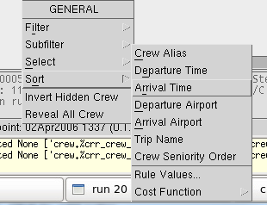
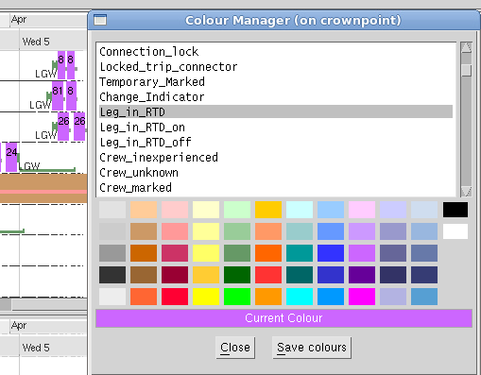
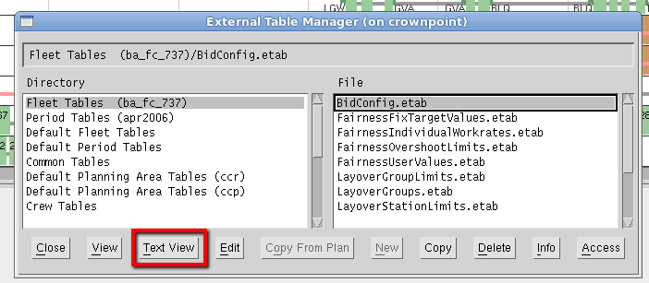
Customizing the system GUI
Notes:
Add toolbar buttons / menus
Change colours and texts in headers and on legs
Add, remove menu entries / override core entries
Override file handlers (e.g. add buttons)
Override forms (e.g. add/remove fields, add picklists…)
Change any colour (personal settings, or coded)

Slide 94
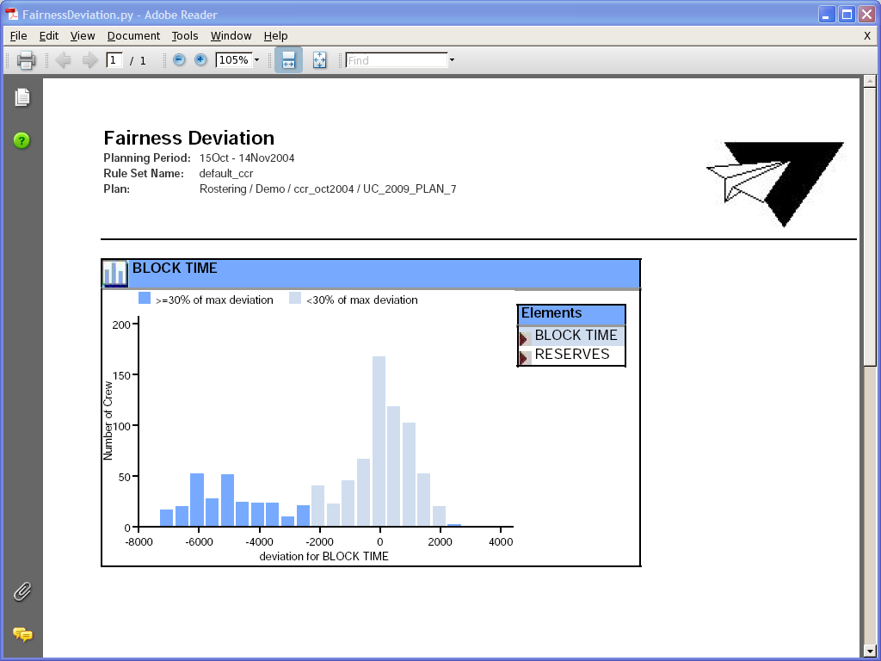
Customizing the system Reports

Slide 95

Customizing the system Reports
Reports
Developer Workspace (DWS)
PRT API
Python APIs
RAVE API
etc..
Report in PDF Format
Report in Studio browser

Slide 96
Customizing the system Automation
Import data
Manual assignment
Optimization
Evaluation
Publication
Pre-processing

Slide 97
Customizing the system Automation
Developer Workspace (DWS)
Core APIs

Slide 98
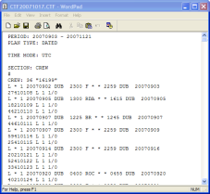

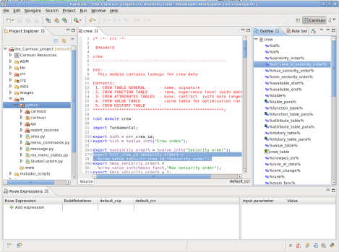
Modelling the Problem and Customizing the System
Summary:
System Core
Report in PDF Format
Report in Studio browser
DWS
CTF Files
PRT API
Core APIs
RAVE API
Java API
Etables
RAVE
Notes:
Note: There will be major differences with Atrium architecture

Slide 99
Exercise 5
~30 mins

Slide 100
Exercise 5 summary
Notes:
Remind all instructors of what may be a good idea to discuss/mention after the exercises...

Slide 101
Chapter 6
The Major Release Process
Service Manager
Installation Quality Visits

Slide 102
The Major Release Process
Made up of:
Carmsys (The Core)
Service Manager
Installation Quality Visits
User Conference Connect Crew & Fleet
Crew & Fleet Developers Partners.

Slide 103

Carmsys (The Core)
R20
R22

Slide 104

Service Manager

Slide 105
Service Manager
CSS is the primary Customer Support and Services entity that works with our customers after handover and during the ongoing rental phase
CSS is the main speaking partner for clients, delivering solutions for operational issues and ensuring the rest of the Jeppesen organization acts upon their thoughts, opinions and worries

Slide 106
Installation Quality Visits
The purpose of the Installation Quality (IQ) review is to ensure that the clients are using Jeppesen Pairing and Rostering products in the best possible way
The ambition with the IQ review is to build a shared vision between Jeppesen and the client organization of what is working well and on potential areas of improvement

Slide 107
UC - Connect Crew & Fleet
UC Connect Crew & Fleet is hosted by different Airlines and occurs every fall
The idea is to share thoughts and experience about how the system is used right now all over the world
One of the most interesting aspects of UC Connect Crew & Fleet is that customers are presenting real cases

Slide 108
CDP – Crew&Fleet Development Partners
CDP occurs every spring in Göteborg
Opportunity for customers to influence & prioritize future core development
The discussions / topics cover short and long term strategies
One of the best side effects to CDP is the networking with other Airlines and the sharing of ideas!
8
9
3

Slide 109
The Major Release Process
Dec
Jan
Nov
Feb
Major Release
Continuous releases
Service Packs (SP)
Oct
Mar
CDP
User’s Conference
Sep
Apr
Aug
May
Jul
Jun

Slide 110
The Major Release Process
Continuous releases / Service packs
About every 3rd week
Components (cold be) released independently
Bug fixes...
and new development
New development may be delivered incrementally, not everything in a big bang
Faster and allows for quicker feedback loops.

Slide 111
Course summary
You have learned:
Planning process
Roles and interaction
The Avocado
Optimization
Modelling the problem and customizing the system
The Major Release Process
You have:
Basic understanding of the capabilities of the crew and fleet products
Basic understanding of the roles needed to use the crew planning products successfully
Basic understanding of the customization possibilities offered

Slide 112


Course Evaluation
Please take a few minutes to complete the evaluation form, it will help us improve the courses for you and your colleagues:
Login:
Start Explorer:
Fill in course information
…and your role (Internal for Jeppesen)
Are the exercise definitions too vague (too real-life), would you like them to be more exact and straight forward?
Would you like to have even more info on slides (for self studying) or would you be stressed about the time constraint?

Slide 113
The end
This was Crew & Fleet Avocado
Welcome back to Jeppesen Crew Academy!

